Slide 1
Back to the basics
Explaining design patterns with real life examples

Slide 2
Generalties
Design patterns are not a one size fits all solution
Each design pattern is a specific solution to a specific problem
It’s important to be identify of the need and/or problem that each pattern attempts to solve

Slide 3
Bridge
https://refactoring.guru/design-patterns/bridge

Slide 4
The problem:
You write a series of classes that end up growing in two different dimensions.

Slide 5
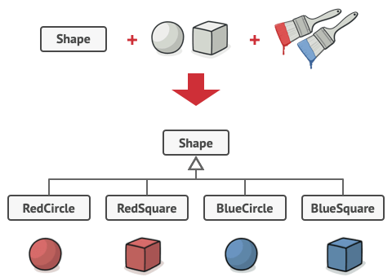
Simple example
Adding a new shape requires creating as many classes as there are colors
Adding a new color requires creating as many classes as there are shapes

Slide 6
The solution
Use composition instead of inheritance (transform the relationship from a “is a” to a “has a”).

Slide 7
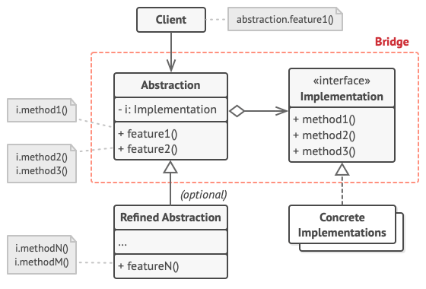
How to do it
Identify the two independent dimensions
Keep one in your class, named formally the “abstraction”
Move the other in an interface, named formally the “implementation”
The abstraction will be the class called by the client code, while the implementation will be used by the abstraction to do its job.
The client code will be the one that has to provide the appropriate implementation to the abstraction.

Slide 8
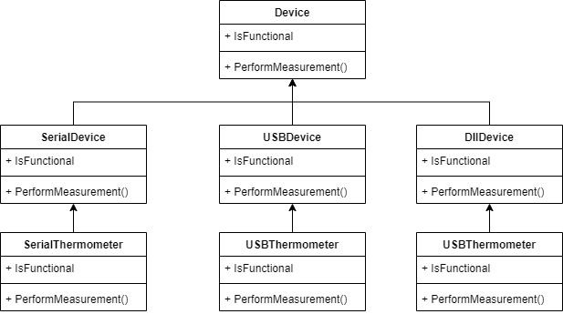
Real life example Context:
The project was a telemedicine application allowing a patient in a cabin to connect to a remote doctor.
The cabin had several devices used to perform measurements on the patient.
The problem: The classes for the devices were extending the functionalities in different directions.

Slide 9
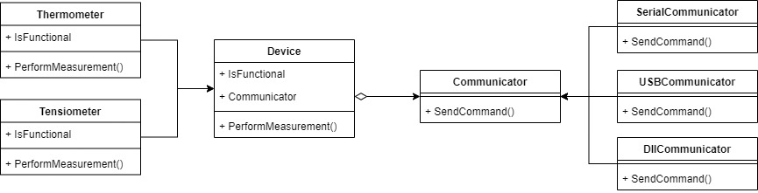
Real life example The solution:
Identify and isolate the growing directions
Keep the devices as the abstraction and the different communication methods as the implementation.

